Slide 1

3D Pie Charts Infographics
Here is where this template begins

Slide 2
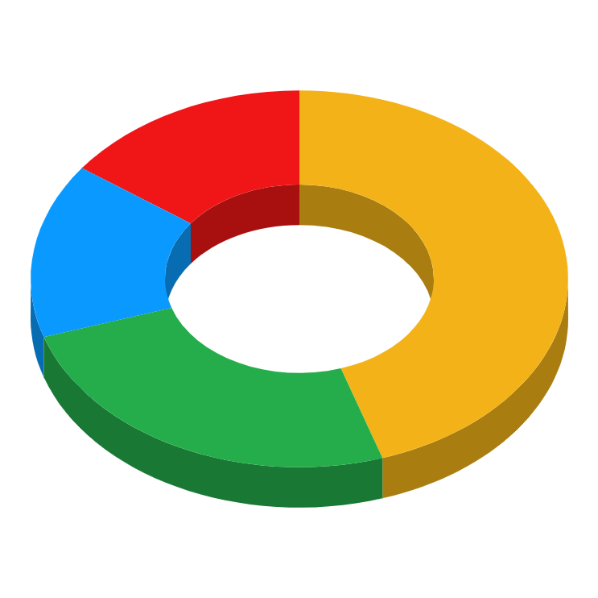
3D Pie Charts Infographics
Mercury
Venus
15%
Mercury is the smallest planet in the Solar System
Venus is the second planet from the Sun
45%
15%
Jupiter
Earth
25%
Jupiter is the biggest planet in the Solar System
Earth is the third planet and is where we all live on
Follow the link in the graph to modify its data and then paste the new one here. For more info, click here

Slide 3
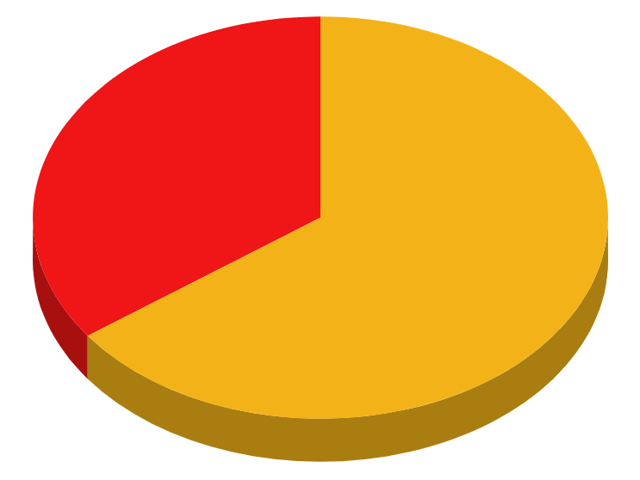
3D Pie Charts Infographics
35%
65%
Mercury
Mars
Mercury is the closest planet to the Sun and the smallest one
Despite being red, Mars is actually a cold place full of iron oxide dust
Follow the link in the graph to modify its data and then paste the new one here. For more info, click here

Slide 4

3D Pie Charts Infographics
1
Despite being red, Mars is actually a cold place
Mars
2
Venus is the second planet from the Sun
Venus
3
Earth is the third planet and is where we live on
Earth
4
It’s the smallest planet in the Solar System
Mercury
Follow the link in the graph to modify its data and then paste the new one here. For more info, click here

Slide 5
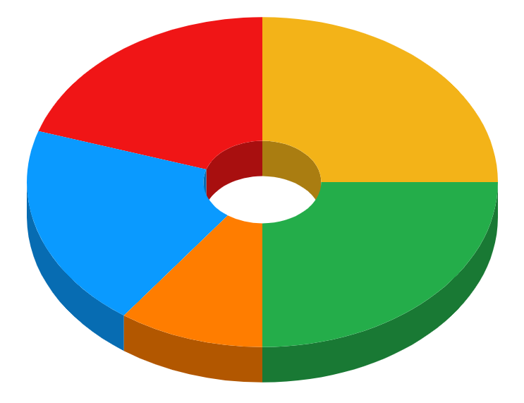
3D Pie Charts Infographics
20%
25%
20%
25%
10%
Jupiter
Saturn
Earth
Mars
Venus
It’s the biggest planet in the Solar System
Saturn is a gas giant and has several rings
Earth is the planet where we all live on
Despite being red, it’s actually a cold place
It’s the second planet from the Sun
Follow the link in the graph to modify its data and then paste the new one here. For more info, click here

Slide 6
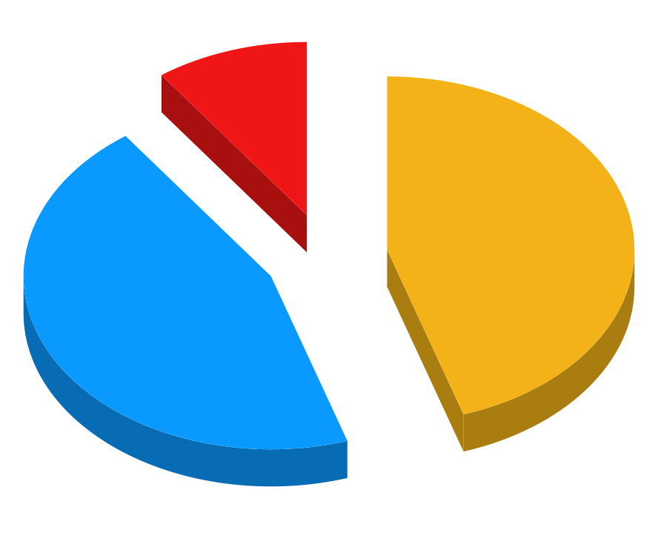
3D Pie Charts Infographics
Mercury
Mercury is the closest planet to the Sun and the smallest one
Venus
Mars
Venus has a beautiful name and is the second planet from the Sun
10%
Despite being red, Mars is actually a cold place full of iron oxide dust
45%
45%
Follow the link in the graph to modify its data and then paste the new one here. For more info, click here

Slide 7
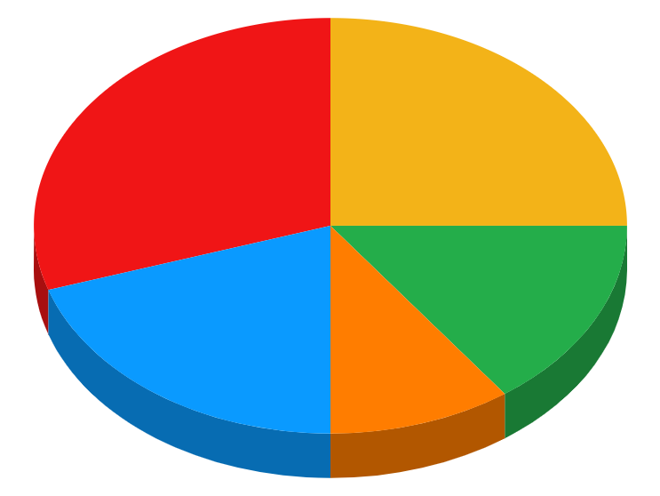
3D Pie Charts Infographics
It’s the smallest planet
Mercury
30%
It’s the biggest planet
Jupiter
25%
It’s where we all live on
Earth
20%
It’s hotter than Mercury
Venus
15%
It’s actually a cold place
Mars
10%
Follow the link in the graph to modify its data and then paste the new one here. For more info, click here

Slide 8
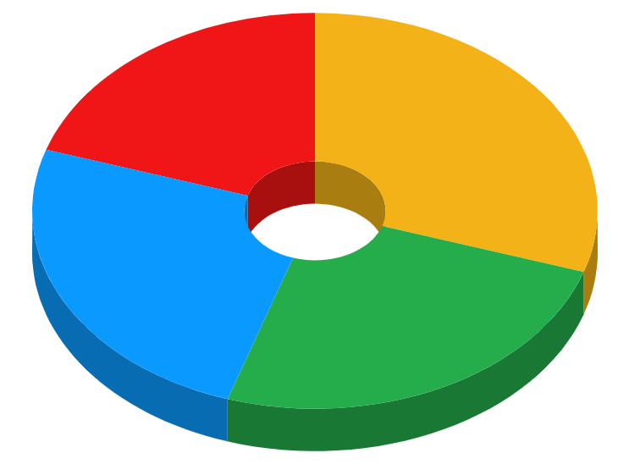
3D Pie Charts Infographics
Venus
20%
30%
Jupiter
Venus is the second planet from the Sun
Jupiter is the biggest planet in the Solar System
Saturn
25%
25%
Mars
Saturn is a gas giant and has several rings
Despite being red, Mars is actually a cold place
Follow the link in the graph to modify its data and then paste the new one here. For more info, click here

Slide 9

3D Pie Charts Infographics
1 | 2 | 3 | 4
10% | 15% | 45% | 30%
Jupiter | Saturn | Earth | Venus
It’s the biggest planet in the Solar System | It’s a gas giant and has several rings | Earth is the planet where we all live on | It’s terribly hot, even hotter than Mercury
1
2
3
4

Slide 10


3D Pie Charts Infographics
Venus
Venus has a beautiful name and is the second planet from the Sun
30%
45%
Follow the link in the graph to modify its data and then paste the new one here. For more info, click here

Slide 11
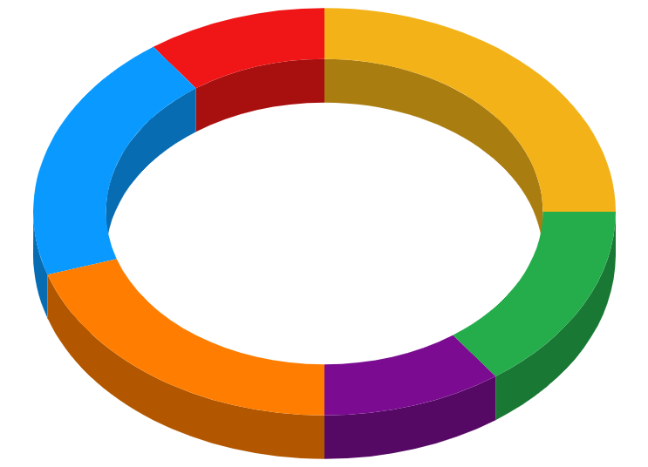
3D Pie Charts Infographics
10%
25%
Earth
Jupiter
Earth is the third planet and is where we all live on
Jupiter is the biggest planet in the Solar System
20%
15%
Saturn
Mars
Saturn is a gas giant and has several rings
20%
10%
Despite being red, Mars is actually a cold place
Venus
Mercury
Venus is the second planet from the Sun
Mercury is the smallest planet in the Solar System
Follow the link in the graph to modify its data and then paste the new one here. For more info, click here

Slide 12
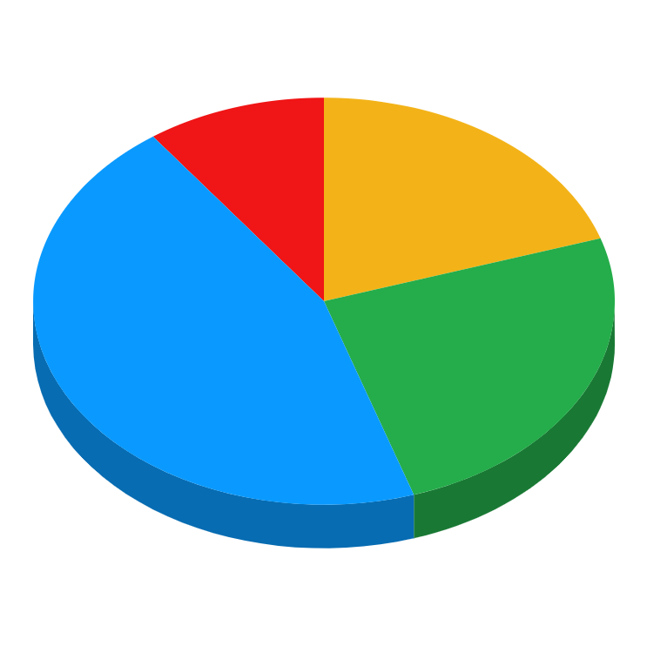
3D Pie Charts Infographics
10%
20%
45%
25%
Mercury
Venus
Saturn
Jupiter
It’s the closest planet to the Sun and the smallest one
Venus has a beautiful name and is terribly hot
Saturn is composed of hydrogen and helium
Jupiter is the biggest planet in the whole Solar System
Follow the link in the graph to modify its data and then paste the new one here. For more info, click here

Slide 13
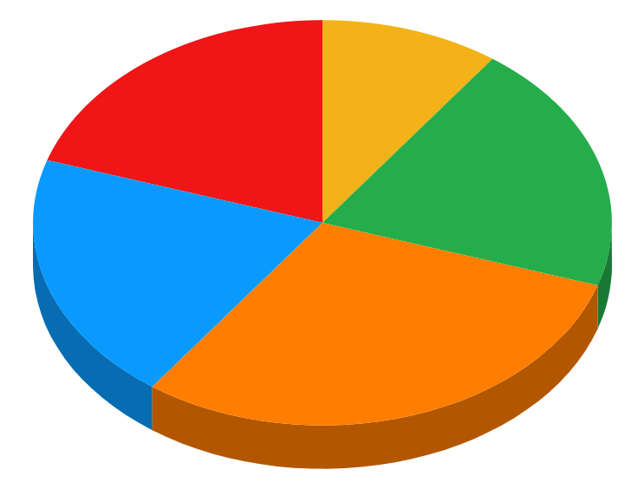
3D Pie Charts Infographics
10%
20%
20%
20%
30%
Jupiter
Saturn
Earth
Mercury
Mars
Jupiter is the biggest planet in the Solar System
Saturn is a gas giant and has several rings
Earth is the third planet and is where we all live on
Mercury is the smallest planet in the Solar System
Despite being red, Mars is actually a cold place
Follow the link in the graph to modify its data and then paste the new one here. For more info, click here

Slide 14
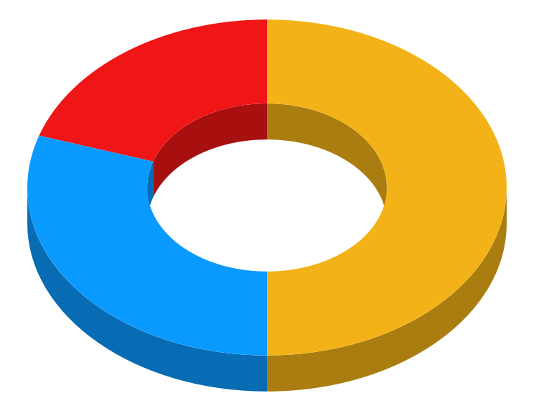
3D Pie Charts Infographics
20%
Mercury
Mercury is the closest planet to the Sun and the smallest one
50%
Venus
It has a beautiful name and is the second planet from the Sun
30%
Jupiter
It’s a gas giant and the biggest planet in the Solar System
Follow the link in the graph to modify its data and then paste the new one here. For more info, click here

Slide 15
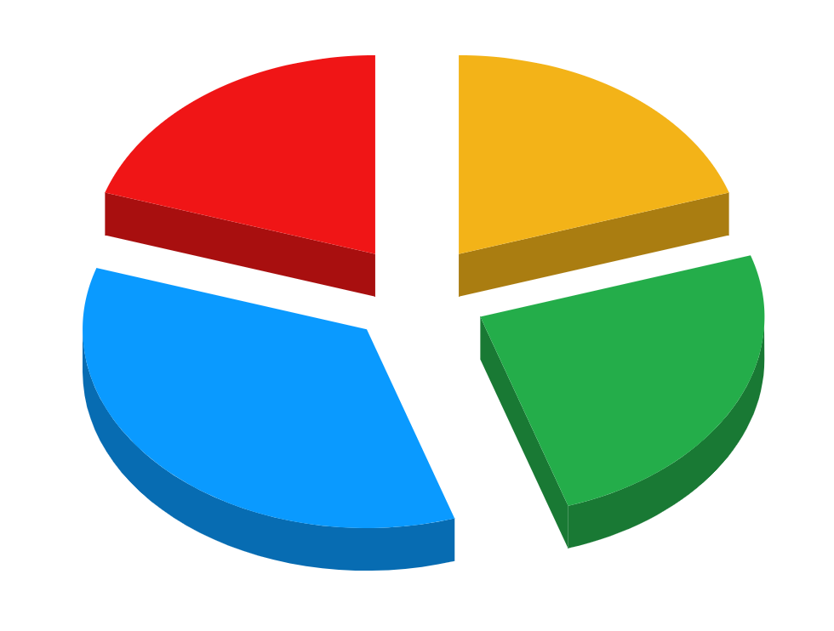
3D Pie Charts Infographics
Mars
20%
Despite being red, it’s actually a cold place full of iron oxide dust
Venus
20%
It has a beautiful name and is the second planet from the Sun
Mercury
35%
Mercury is the closest planet to the Sun and the smallest one
Jupiter
25%
It’s a gas giant and the biggest planet in the Solar System
Follow the link in the graph to modify its data and then paste the new one here. For more info, click here

Slide 16
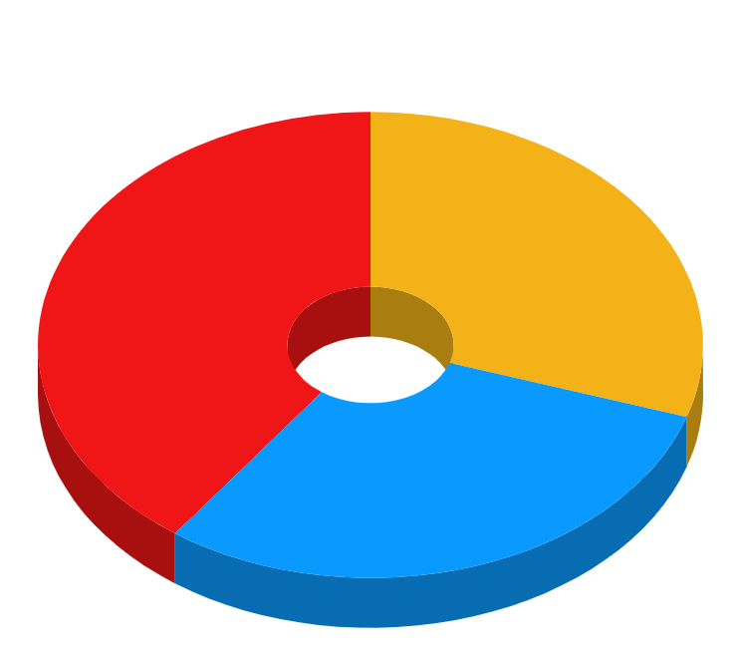
3D Pie Charts Infographics
1
10% | 15% | 45%
Mercury | Jupiter | Mars
Mercury is the closest planet to the Sun and the smallest one | Jupiter is a gas giant and the biggest planet in the Solar System | Despite being red, Mars is actually a cold place full of iron oxide dust
Follow the link in the graph to modify its data and then paste the new one here. For more info, click here

Slide 17

3D Pie Charts Infographics
Jupiter
Mercury
Jupiter is the biggest planet in the Solar System
Mercury is the smallest planet in the Solar System
Saturn
15%
25%
Mars
Saturn is a gas giant and has several rings
Despite being red, Mars is actually a cold place
35%
25%
Follow the link in the graph to modify its data and then paste the new one here. For more info, click here

Slide 18
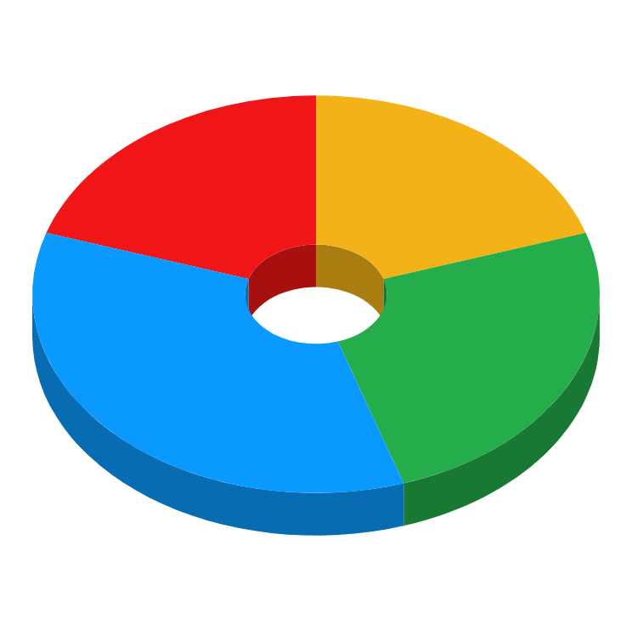
3D Pie Charts Infographics
Earth
20%
20%
Jupiter
Earth is the third planet and is where we all live on
Jupiter is the biggest planet in the Solar System
Mercury
Mars
Mercury is the smallest planet in the Solar System
Despite being red, Mars is actually a cold place
35%
25%
Follow the link in the graph to modify its data and then paste the new one here. For more info, click here

Slide 19
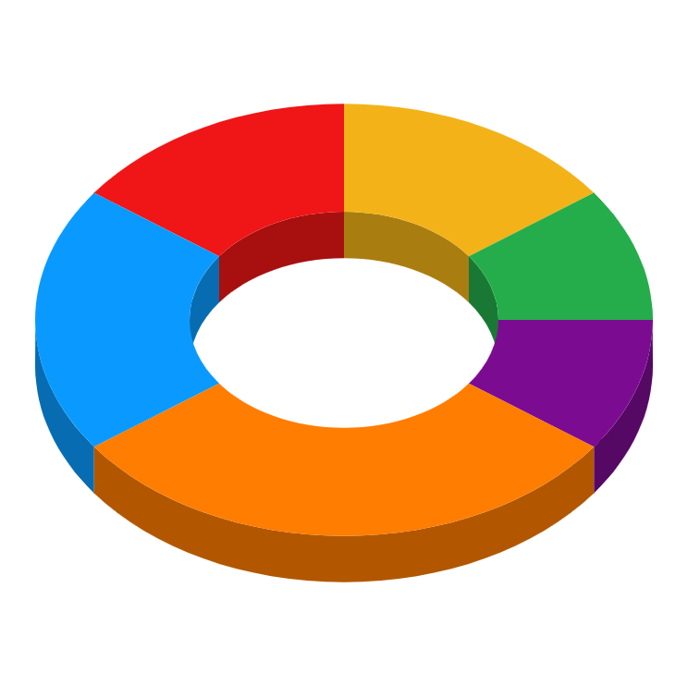
3D Pie Charts Infographics
Venus
Jupiter
It’s the second planet from the Sun
15%
15%
It’s the biggest planet in the Solar System
Mercury
Mars
It’s the smallest planet in the Solar System
20%
10%
Despite being red, it’s actually a cold place
Saturn
Earth
Saturn is a gas giant and has several rings
30%
10%
Earth is the planet where we all live on
Follow the link in the graph to modify its data and then paste the new one here. For more info, click here

Slide 20
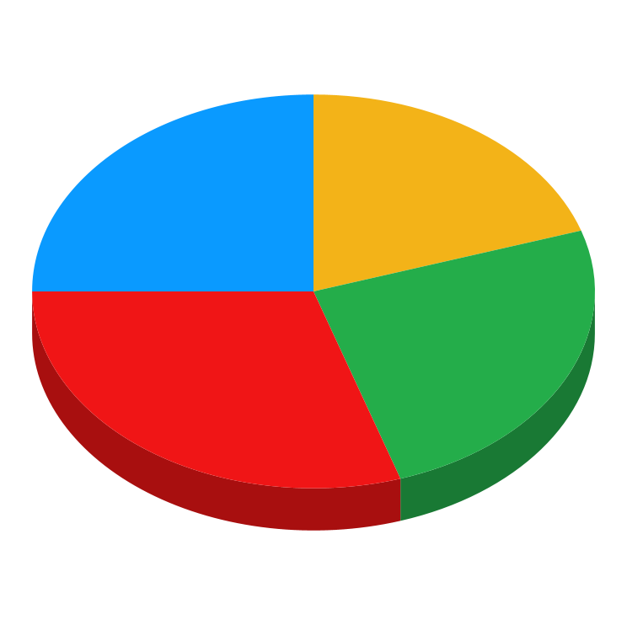
3D Pie Charts Infographics
Venus
Saturn
Jupiter
Mars
Venus is the second planet from the Sun
Saturn is a gas giant and has several rings
Jupiter is the biggest planet in the Solar System
Despite being red, Mars is actually a cold place
30%
25%
20%
25%
Follow the link in the graph to modify its data and then paste the new one here. For more info, click here

Slide 21
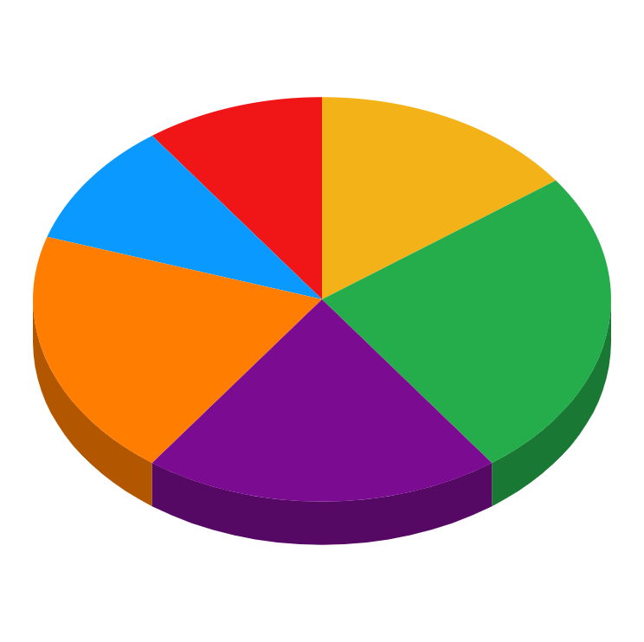
3D Pie Charts Infographics
Venus
Mercury
Venus is hotter than Mercury
10%
15%
Mercury is the smallest planet
Mars
Saturn
Mars is actually a cold place
10%
25%
Saturn has several rings
Earth
Jupiter
Earth is where we all live on
20%
20%
Jupiter is the biggest planet
Follow the link in the graph to modify its data and then paste the new one here. For more info, click here

Slide 22
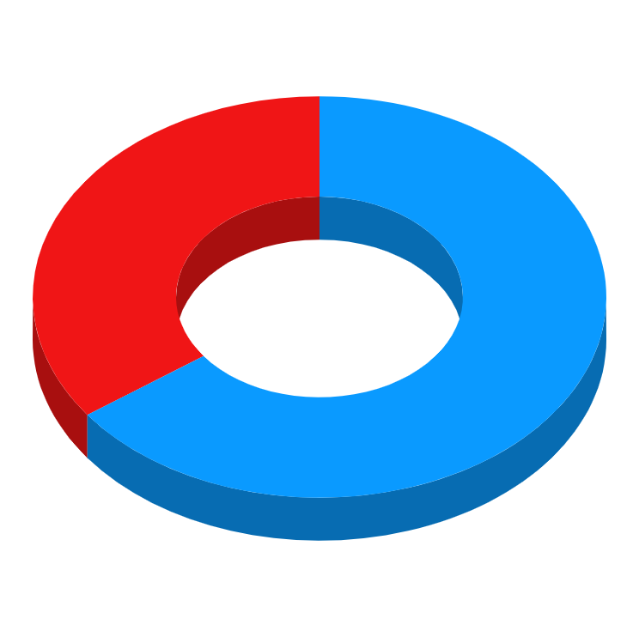
3D Pie Charts Infographics
Mercury is the closest planet to the Sun and the smallest one
Despite being red, it’s actually a cold place full of iron oxide dust
Mercury
35%
Mars
65%
Jupiter is a gas giant and the biggest planet in the Solar System
Earth is the third planet and is where we all live on
Follow the link in the graph to modify its data and then paste the new one here. For more info, click here

Slide 23
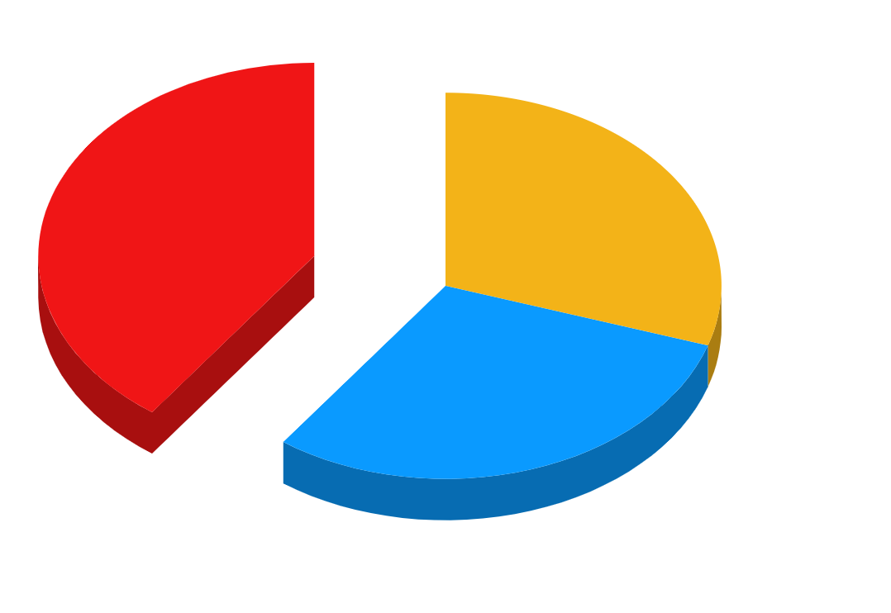
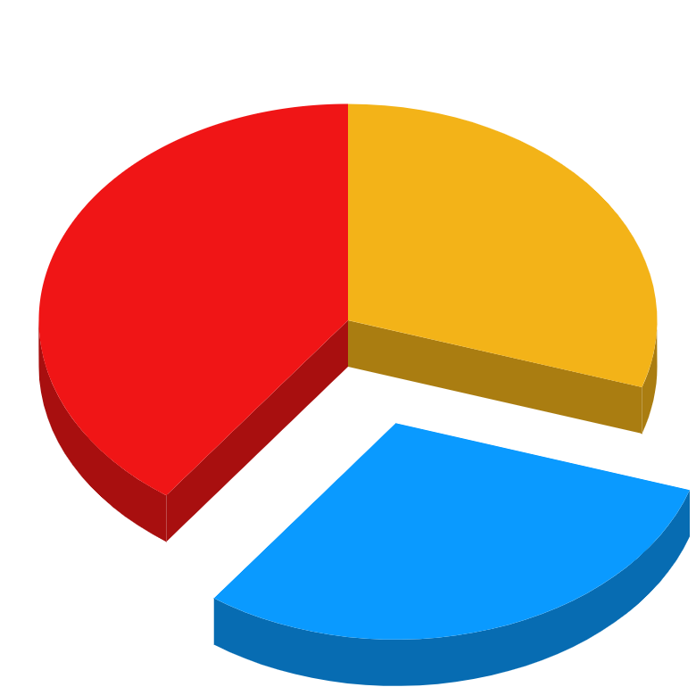
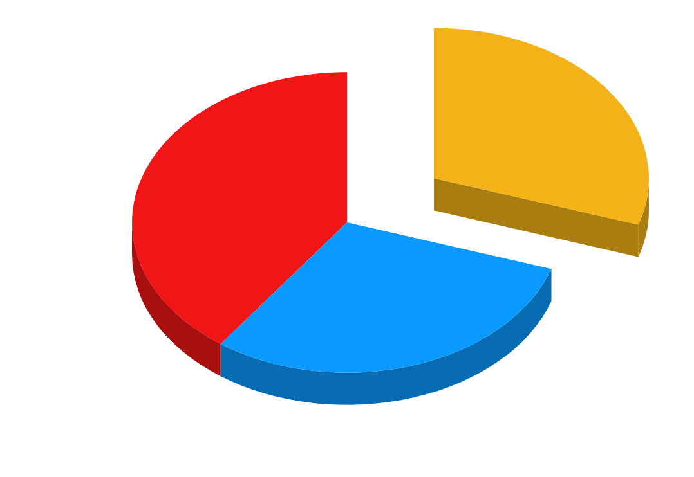
3D Pie Charts Infographics
40%
30%
30%
Mercury
Venus
Mars
Mercury is the closest planet to the Sun and the smallest one
Venus has a beautiful name and is the second planet from the Sun
Despite being red, Mars is actually a cold place full of iron oxide dust
Follow the link in the graph to modify its data and then paste the new one here. For more info, click here

Slide 24
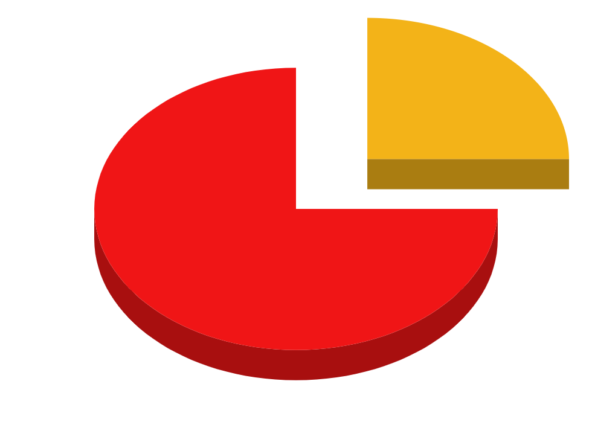
3D Pie Charts Infographics
Venus
25%
Venus has a beautiful name and is the second planet from the Sun
Mercury
75%
Mercury is the closest planet to the Sun and the smallest one
Follow the link in the graph to modify its data and then paste the new one here. For more info, click here

Slide 25
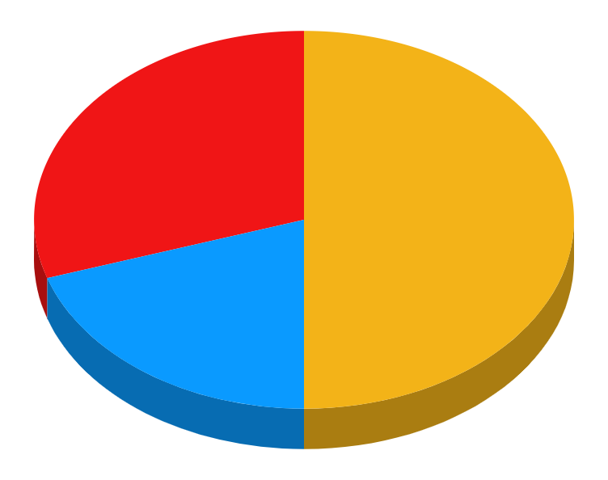
3D Pie Charts Infographics
30% | 50% | 20%
Earth
Venus
Mercury
Earth is the planet where we all live on
It’s the second planet from the Sun
Mercury is the smallest planet
Follow the link in the graph to modify its data and then paste the new one here. For more info, click here

Slide 26
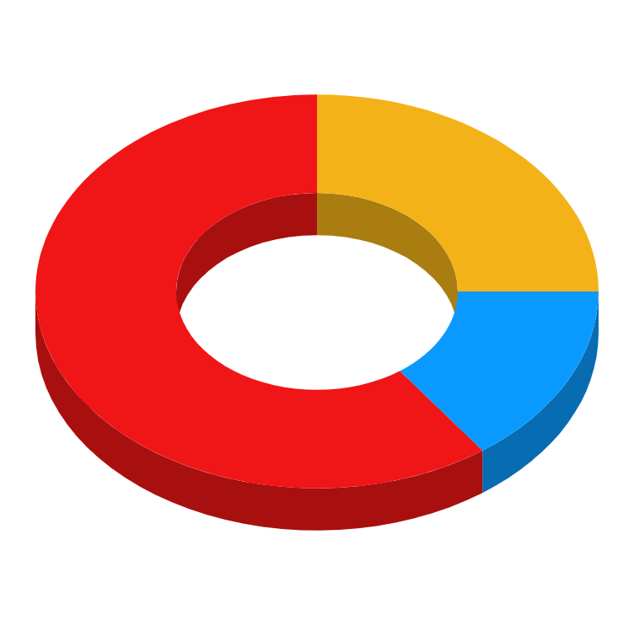
3D Pie Charts Infographics
60%
Venus
Venus has a beautiful name and is the second planet from the Sun
25%
Mars
Despite being red, it’s actually a cold place full of iron oxide dust
15%
Mercury
Mercury is the closest planet to the Sun and the smallest one
Follow the link in the graph to modify its data and then paste the new one here. For more info, click here

Slide 27

3D Pie Charts Infographics
Earth
Venus
Earth is the third planet and is where we all live on
Venus is the second planet from the Sun
Jupiter
Mars
Jupiter is the biggest planet in the Solar System
Despite being red, Mars is actually a cold place

Slide 28
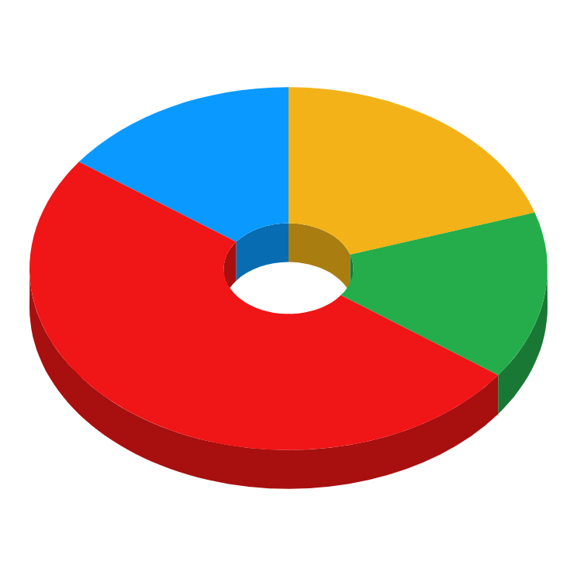
3D Pie Charts Infographics
15%
20%
Mars
Mercury
It’s actually a cold place
It’s the smallest planet
It has high temperatures
Earth is the third planet
Venus
Earth
50%
15%
Follow the link in the graph to modify its data and then paste the new one here. For more info, click here

Slide 29
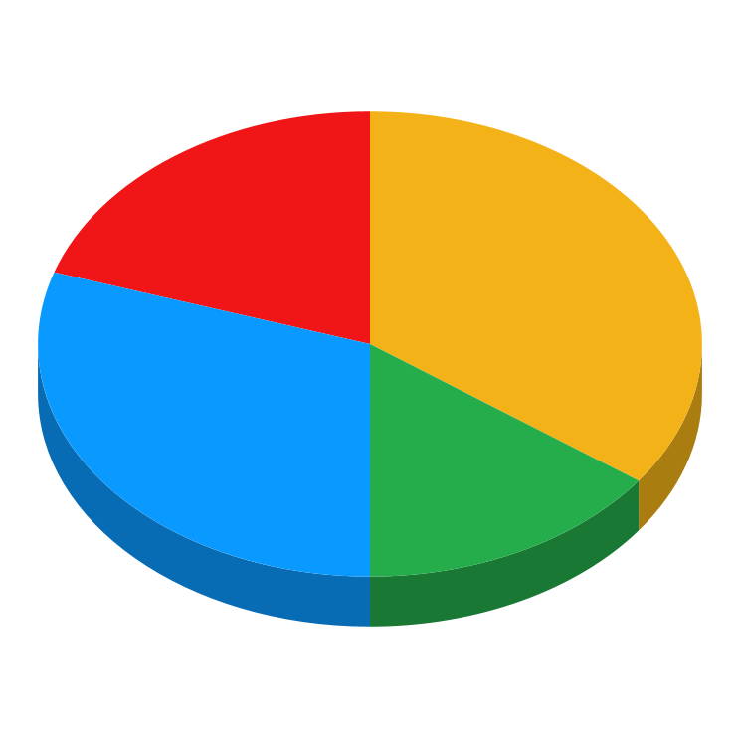
3D Pie Charts Infographics
20%
Earth
Earth is the planet where we all live on
Mercury
35%
Mercury is the smallest planet
30%
Neptune
It’s the farthest planet to the Sun
Saturn
15%
It’s a gas giant and has several rings
Follow the link in the graph to modify its data and then paste the new one here. For more info, click here

Slide 30

3D Pie Charts Infographics
It was named after the Roman god of wealth and agriculture
Saturn
Venus
30%
20%
Mercury is the closest planet to the Sun and the smallest one
Despite being red, it’s actually a cold place full of iron oxide dust
30%
20%
It’s a gas giant and the biggest planet in the Solar System
Mars
Jupiter
Follow the link in the graph to modify its data and then paste the new one here. For more info, click here

Slide 31
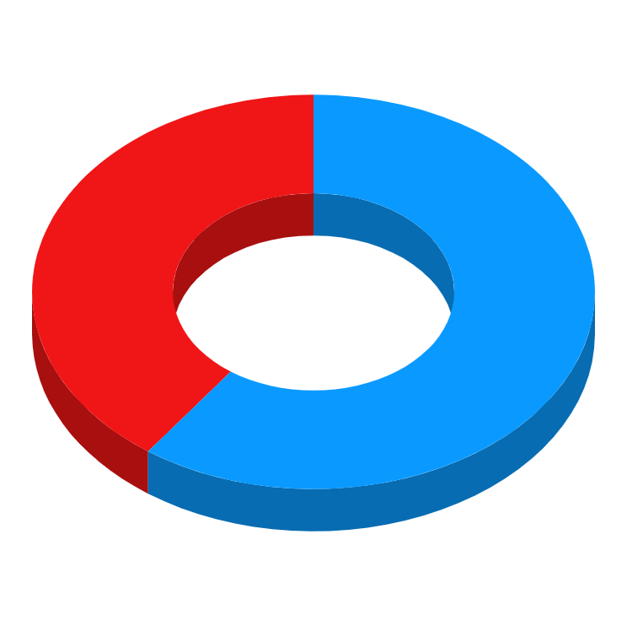

3D Pie Charts Infographics
Follow the link in the graph to modify its data and then paste the new one here. For more info, click here
60%
40%
45%
55%
Venus
Saturn
Earth
Jupiter
Venus is the second planet from the Sun
Saturn is a gas giant and has several rings
Earth is the third planet and is where we live on
It’s the biggest planet in the Solar System

Slide 32
Instructions for use (premium users)
If you are a Premium user on Slidesgo, you can use this template without attributing Slidesgo.
You are allowed to:
Modify this template.
Use it for both personal and commercial purposes.
Hide or delete the “Thanks” slide and the mention to Slidesgo in the credits.
Share this template in an editable format with people who are not part of your team.
You are not allowed to:
Sublicense, sell or rent this Slidesgo Template (or a modified version of this Slidesgo Template).
Distribute this Slidesgo Template (or a modified version of this Slidesgo Template) or include it in a database or in any other product or service that offers downloadable images, icons or presentations that may be subject to distribution or resale.
Use any of the elements that are part of this Slidesgo Template in an isolated and separated way from this Template.
Register any of the elements that are part of this template as a trademark or logo, or register it as a work in an intellectual property registry or similar.
For more information about editing slides, please read our FAQs or visit Slidesgo School:
https://slidesgo.com/faqs and https://slidesgo.com/slidesgo-school

Slide 33
Infographics
You can add and edit some infographics to your presentation to present your data in a visual way.
Choose your favourite infographic and insert it in your presentation using Ctrl C + Ctrl V or Cmd C + Cmd V in Mac.
Select one of the parts and ungroup it by right-clicking and choosing “Ungroup”.
Change the color by clicking on the paint bucket.
Then resize the element by clicking and dragging one of the square-shaped points of its bounding box (the cursor should look like a double-headed arrow). Remember to hold Shift while dragging to keep the proportions.
Group the elements again by selecting them, right-clicking and choosing “Group”.
Repeat the steps above with the other parts and when you’re done editing, copy the end result and paste it into your presentation.
Remember to choose the “Keep source formatting” option so that it keeps the design. For more info, please visit Slidesgo School.

